Slide 1

Reddit API Scarper
Web and Social Media Analytics
May 2025
BADS
Camilio Mercado
Pablo Alfaro
Hamza Ben Amara

Slide 2
Table of contents
01
02
03
04
05
06
Business & Context
Definition of the idea
Dataset description
Analysis & Motivation
Methods & Strategies adopted
Conclusion

Slide 3

01
Business & Context

Slide 4


Business & Context
In today’s tech and digital environment, brands and products in the sportswear industry, especially football boots are subject to constant scrutiny and discussion on social media platforms. Understanding how consumers perceive these products in online spaces can provide strategic insights for marketing, product design, and customer engagement.
Reddit, being a popular platform for authentic and in online discussions, offers valuable qualitative data.
By analyzing Reddit posts and comments related to "Top 90 football boots", businesses can uncover trends in consumer preferences, identify brand perception gaps, and better align product offerings with market expectations.

Slide 5

02
Definition of the idea

Slide 6

Definition of the idea
The core idea of this project is to leverage Reddit data to perform a sentiment and content analysis of discussions around top football boots.
This analysis aims to:
Extract public opinions and perceptions on leading football boots
Identify recurring themes such as price sensitivity, design appeal, and performance
Help sportswear brands make data-driven decisions in product development and marketing
This project provides a practical case of web and social media analytics applied to consumer behavior in the sports apparel market.

Slide 7

03
Dataset description

Slide 8
Data description
The dataset was collected using a Reddit scraper written in Python. The script targeted posts and comments containing the keyword “Top 90 football boots” from relevant subreddits.
After scraping:
Texts were cleaned by removing stop words, special characters, and links
A sentiment score was assigned to each comment using VADER sentiment analysis
Comments were classified as positive, negative, or neutral
The resulting dataset includes:
Reddit post titles
Cleaned comment text
Sentiment scores and categories
Indicators for specific themes like price sensitivity

Slide 9


04
Analysis & Motivation

Slide 10
Analysis & Motivation
Price sensitivity analysis
We identified comments that included price-related terms like “expensive”, “cheap”, or “worth it”. These comments were disproportionately negative, suggesting that pricing is a major source of dissatisfaction.
Even when users appreciate a boot’s performance or design, high prices often trigger frustration, especially if the value isn’t clearly communicated.
This highlights the need for:
Clearer justification of pricing
Budget-friendly product lines
Messaging that reinforces product value
Motivation for analysis choices
Reddit offers honest and unfiltered feedback, ideal for natural language analysis
Sentiment classification allows quick mapping of brand perception
Price analysis adds business-relevant depth to raw emotional data

Slide 11
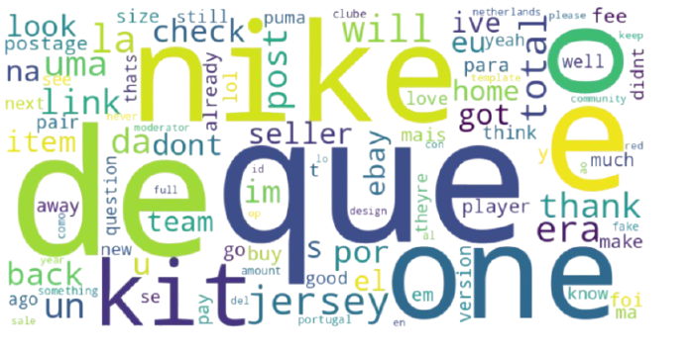
Word cloud of design-related comments
The word cloud reveals that much of the online discussion centers around Nike and its product lines, particularly kits and jerseys. The frequent mention of terms like “love,” “thanks,” and “will” suggests a generally positive emotional tone, while words like “fake” and “dont” hint at concerns regarding authenticity or quality. This indicates a strong brand presence with both loyal customer engagement and areas needing attention.

Slide 12
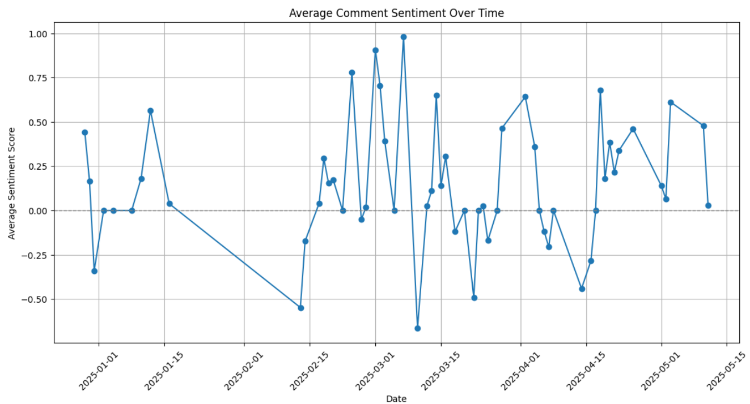
Sentiment Analysis Over Time
The graph of average comment sentiment over time shows sharp fluctuations, with spikes and drops occurring irregularly.
The highest peaks, especially around January 1, 2025, and March 2025, suggest that particular events or discussions during these periods might have generated more positive sentiments or excited comments.
On the negative side, there are dips, notably in mid-February and April 2025, showing that certain periods may have seen frustration or dissatisfaction from users, possibly relating to issues like product availability, pricing, or disappointments with the products discussed.
Irregular peaks in sentiment could be attributed to specific events causing spikes in positive sentiment or reactions.
Overall Interpretation: The sentiment over time shows clear volatility, with certain dates generating high excitement or positive reactions, while others indicate frustration or negative sentiments. This fluctuation might be a result of various external factors, such as promotions, news events, or personal experiences shared by the community regarding the products.

Slide 13
05
Methods & Strategies adopted

Slide 14
Methods & Strategies adopted
Tools and technologies
Programming language: Python
Data Collection: Pushshift Reddit API
Sentiment Analysis: VADER (Valence Aware Dictionary and sEntiment Reasoner)
Visualization: Matplotlib, Seaborn, WordCloud
Steps followed
We began by scraping data from Reddit using the keyword “Top 90 football boots”, targeting high-engagement, user-generated content that reflects genuine customer opinions. The text data was then preprocessed through tokenization, lowercasing, and removal of stopwords to prepare it for analysis. We applied VADER sentiment analysis to compute sentiment scores and classify each comment as positive, neutral, or negative. Additionally, we manually identified and tagged price related keywords to explore how pricing influences sentiment. The processed data was then visualized using pie charts, bar plots, and word clouds, capturing both the emotional tone and thematic relevance, particularly around pricing and design. We chose lightweight and accessible tools to keep the process flexible and enable the development of a potential prototype or future extensions.

Slide 15
06
Conclusion

Slide 16
Conclusion
Conclusion :
This analysis of Reddit discussions around "Top 90 football boots" highlights the powerful role of social media in shaping and reflecting consumer perceptions. Through sentiment analysis and thematic exploration, we found that most users express positive feelings about football boots, particularly praising comfort, design, and value. However, recurring negative sentiments, especially around pricing and durability offer actionable insights for brands. Social media analytics, therefore, serve as a vital tool for aligning product strategy with real user expectations.
Recommendations :
Adjust pricing strategies or communicate value more clearly to address cost-related concerns.
Prioritize product quality and comfort, as these drive both positive feedback and brand loyalty.
Monitor online forums regularly to detect shifts in consumer sentiment early.
Engage with Reddit communities directly to humanize the brand and gather feedback.
Compare sentiment across competitors to better position your own offerings.

Slide 17

Thanks!

